Slide 1
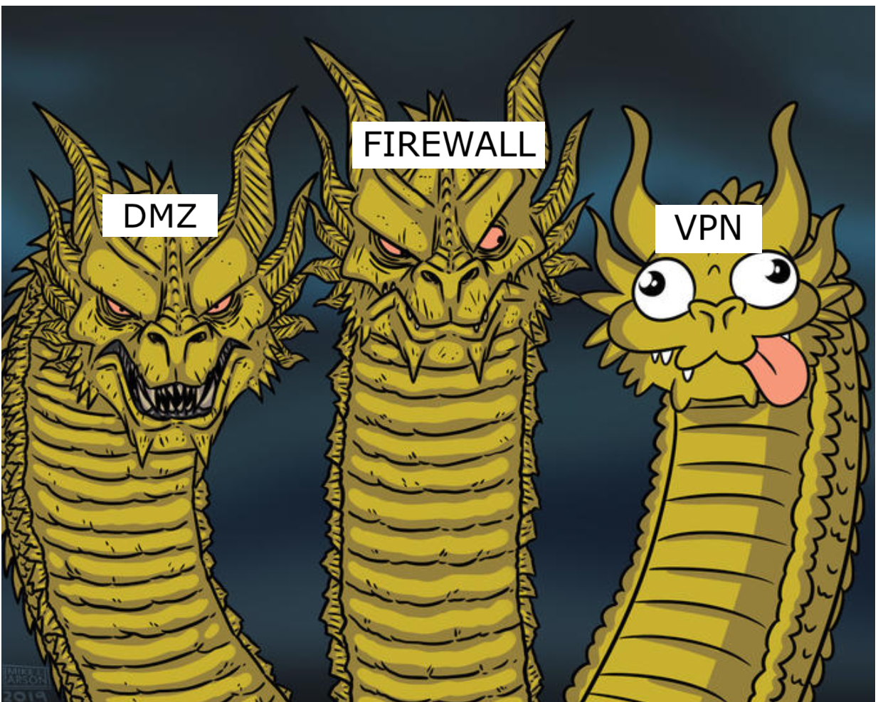

IS-IS PRESENTATION
Notes:
1

Slide 2
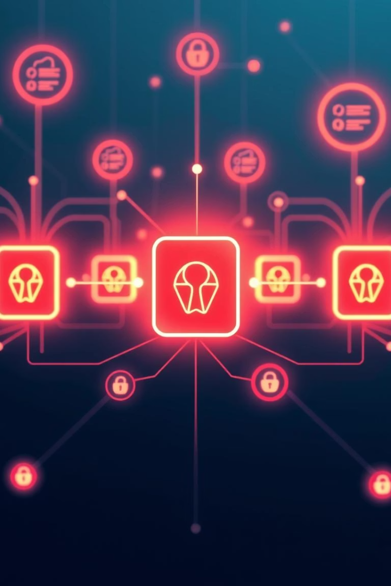

Firewall Configurations, VPNs, and DMZs: Securing Your Network
In today's digital landscape, securing networks against evolving cyber threats is critical. This presentation will explore key components of network security: firewall configurations, VPN technologies, and DMZ architectures. You'll gain practical insights into configuring firewalls effectively, choosing the right VPN protocols, and designing DMZs to protect public-facing services.
We will also examine how these elements integrate to form a robust defense strategy, complete with real-world examples. Whether you're a network admin or security professional, this guide will enhance your understanding of enterprise-grade network protection.
Notes:
1

Slide 3

Firewalls, VPNs, and DMZs are three simple building blocks for network safety.
A firewall acts like a filter—letting good traffic in and keeping bad traffic out.
A VPN wraps your data in encryption, so it can travel safely over the internet.
A DMZ is a small, separate zone for public-facing servers; if one of them gets hit, your private network stays protected. Together, these tools create layers of defense that keep hackers away while still letting your users work and share information.

Slide 4
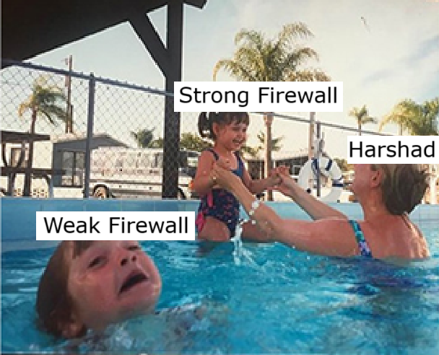
Understanding Firewalls: The First Line of Defense
Firewall Basics
Firewalls act as gatekeepers, controlling inbound and outbound traffic based on predetermined security rules. They monitor and filter data packets to block malicious traffic and unauthorized access attempts.
Notes:
3

Slide 5
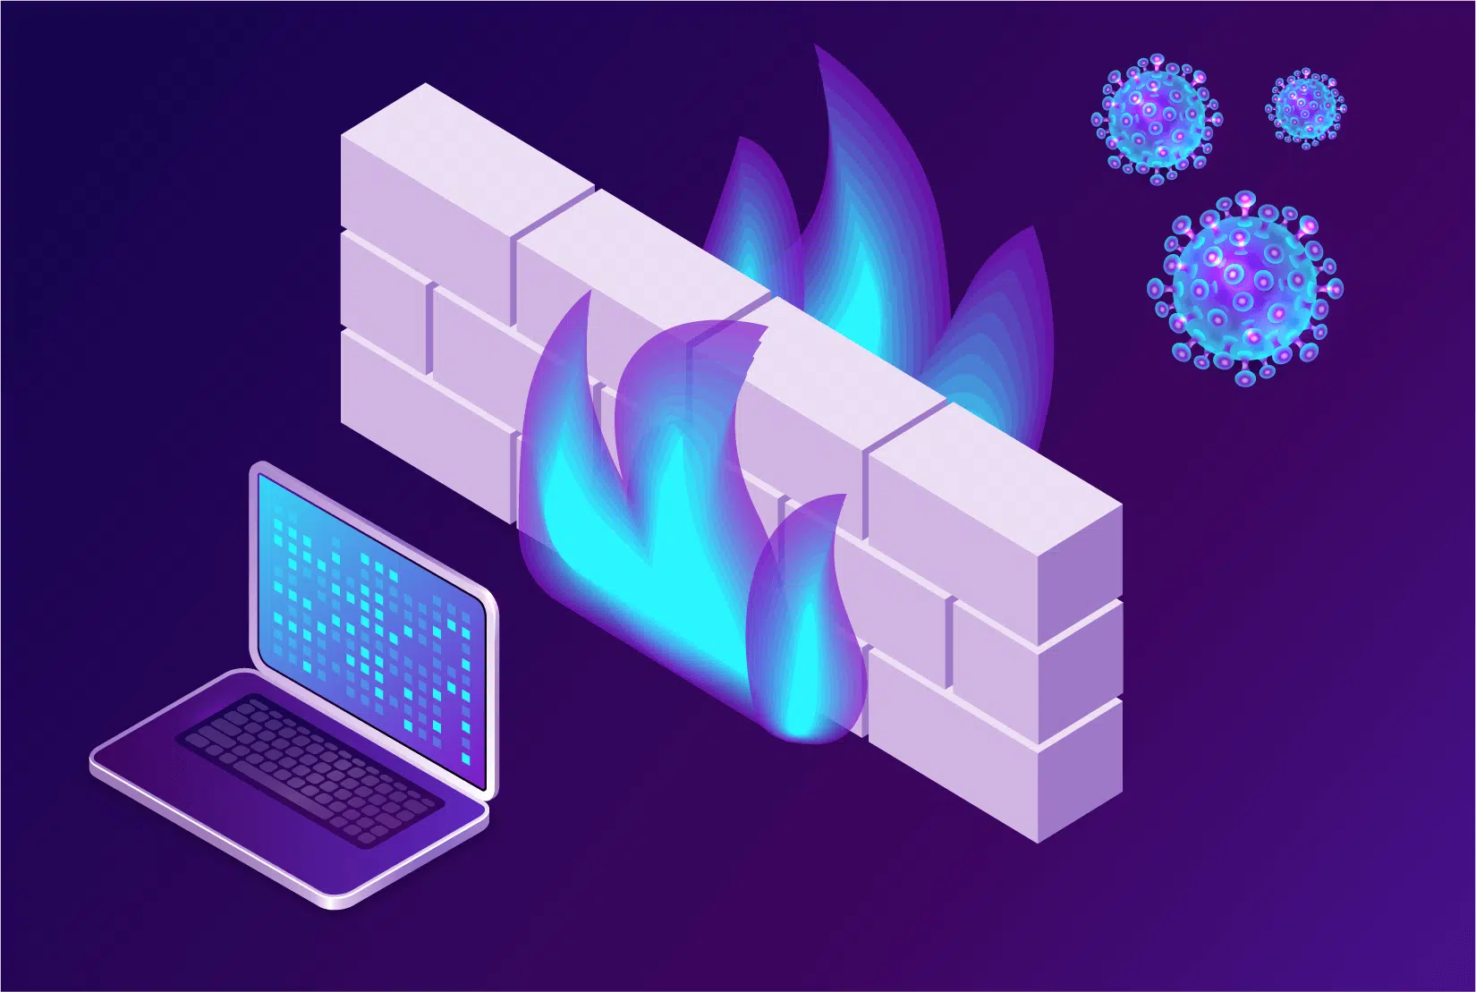
Types of Firewalls
Different firewalls cater to various needs, including network, host-based, and next-generation firewalls. Each type offers unique inspection capabilities and protection levels.
1.Packet Filters
•Stateful packet filters
•Stateless packet filters
2. Application Gateway
3.Circuit Level Gateway

Slide 6
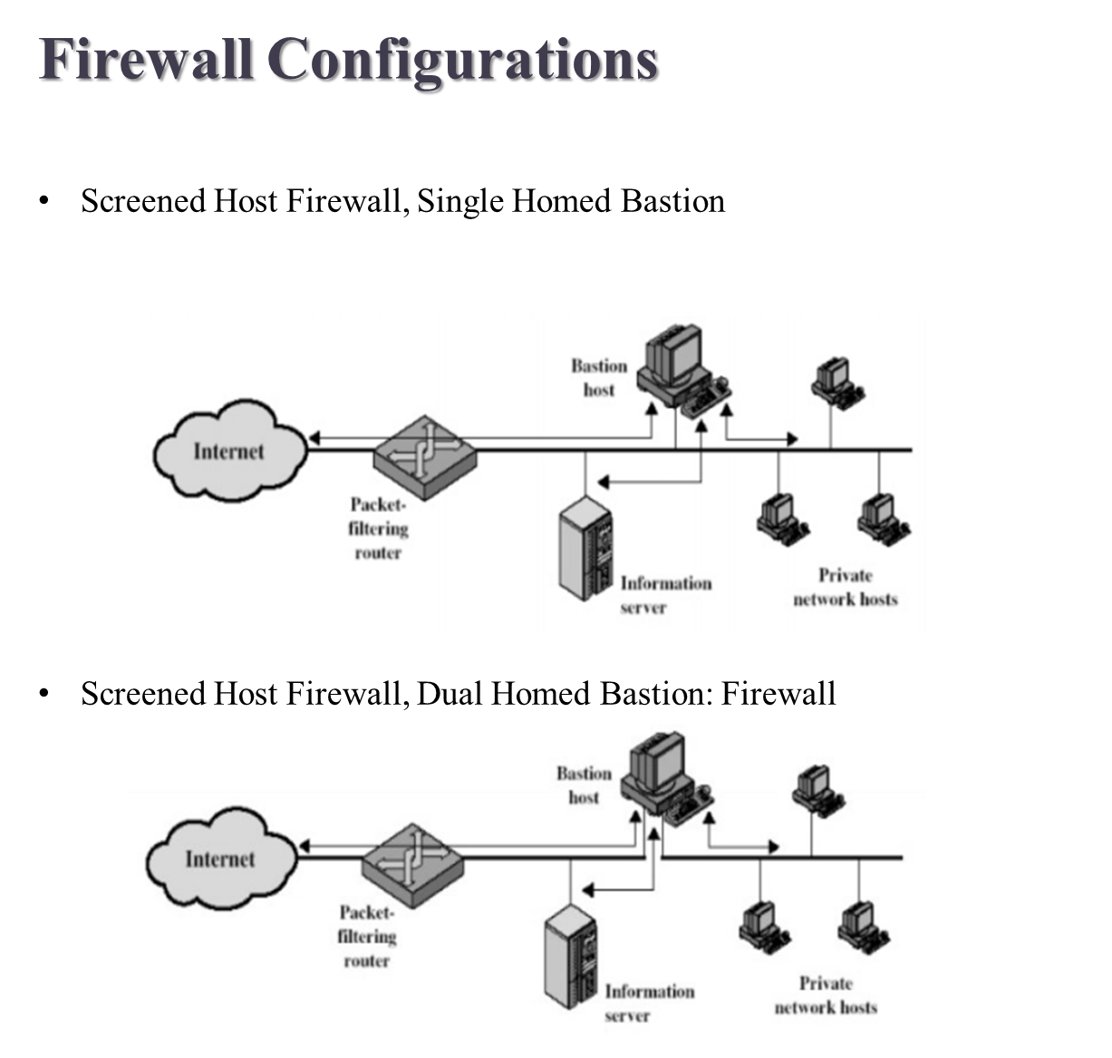

Slide 7

Best Practices for Firewalls: Rule Sets and Policies
Minimize Open Ports
Only open necessary ports to reduce attack surface. Unused ports should remain closed or blocked by default.
Use Explicit Deny Rules
All traffic not explicitly allowed should be blocked, enforcing a "deny by default" approach for strict security.
Regularly Review Rules
Continuously audit and update rule sets to remove obsolete entries and adapt to new threats or business requirements.
Implement Logging and Alerts
Enable detailed logs and real-time alerts to quickly detect and respond to suspicious activities or breaches.
Notes:
5

Slide 8

VPNs
A VPN (Virtual Private Network) is used to keep your internet connection safe and private. It hides what you do online from others—like hackers, your internet provider, or websites—by creating a secure, encrypted “tunnel” for your data. It can also help you access websites or content that might be blocked in your country.
So basically, a VPN:
Protects your privacy online.
Keeps your data safe from spying or theft.
Lets you browse the internet more freely.
Notes:
6

Slide 9

After missing text from priya who lived 2 miles away from my house
Notes:
6

Slide 10

Types of VPNs
Remote-access VPN: a secure way for a single user to reach the office network from home or while traveling.
Site-to-site VPN: joins two whole offices together over the internet so they work like one big network.
SSL/TLS VPN (browser-based): you open a web browser, log in over HTTPS, and you’re safely inside—no special app needed.
IPsec VPN: uses a standard internet security protocol to lock (encrypt) every packet that goes between two points.
MPLS VPN: a service your internet provider offers to keep different customers’ traffic separate on its backbone—more about isolated routing than encryption.
Mobile VPN: keeps your phone or tablet connected through one steady tunnel even as it hops between Wi-Fi and cellular networks.

Slide 11
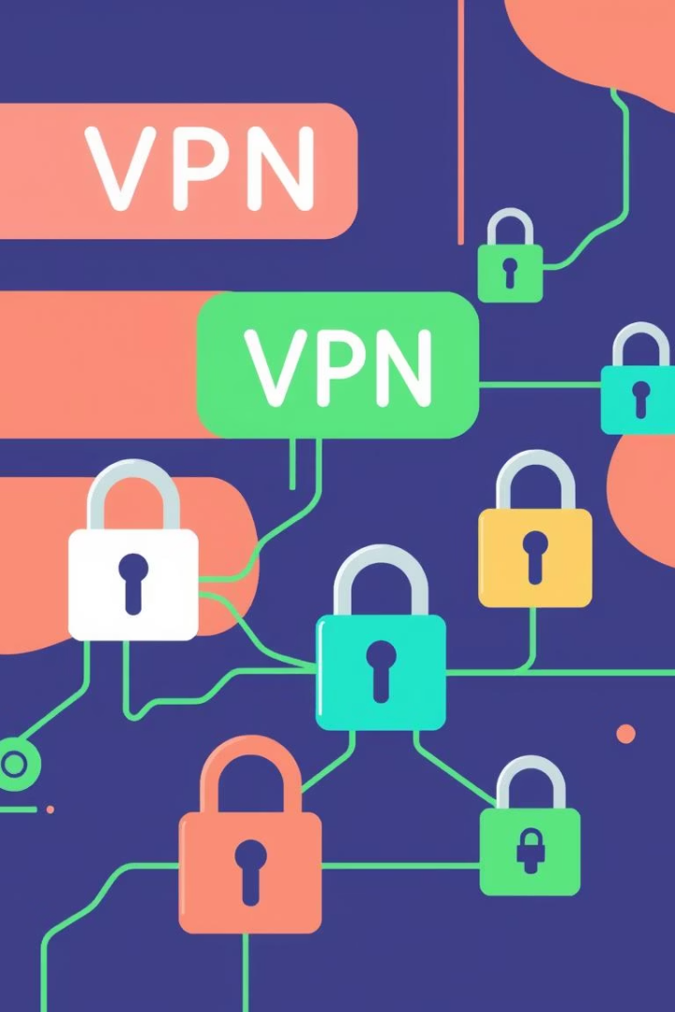
VPN Protocols: Choosing the Right Option (IPsec, SSL/TLS, etc.)
IPsec
SSL/TLS
A widely used protocol providing robust encryption for secure IP communications, often employed in site-to-site VPNs.
Commonly used in remote access VPNs, offering strong encryption with ease of client connectivity through standard web browsers.
Strong encryption and authentication
Operates at the transport layer
Operates at the network layer
Supports clientless VPN access
Other Protocols
Includes protocols like L2TP, PPTP, and newer options such as WireGuard, balancing performance and security.
Varying encryption strengths
Different device compatibilities
Notes:
8

Slide 12
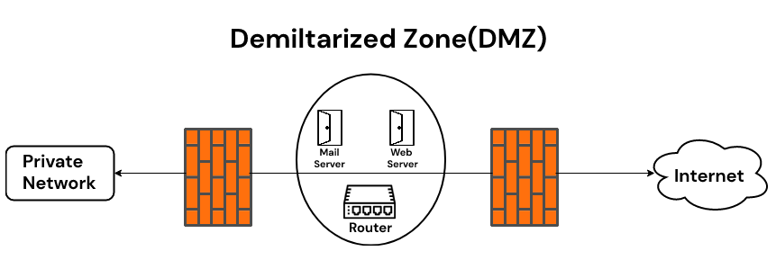
DMZs: Isolating Public-Facing Services
A DMZ is a separate network placed between the internet and your private network. It hosts public servers like websites and email. If these servers are attacked, the DMZ keeps the threat isolated and protects your internal network from being accessed.
Notes:
9

Slide 13
Common DMZ Services
Essential DMZ Services :
Web Server (HTTP/HTTPS) – delivers your public website; isolating it in the DMZ keeps web-based attacks away from internal systems.
Mail Server (SMTP) – accepts external email; if compromised, the damage stays confined to the DMZ instead of spreading to your LAN.
DNS Server – translates your domain names for outside users; placing it in the buffer zone prevents DNS exploits from touching core resources.
FTP/SFTP Server – provides a spot for partners or clients to upload/download files; DMZ placement limits exposure if credentials leak or malware is uploaded.

Slide 14
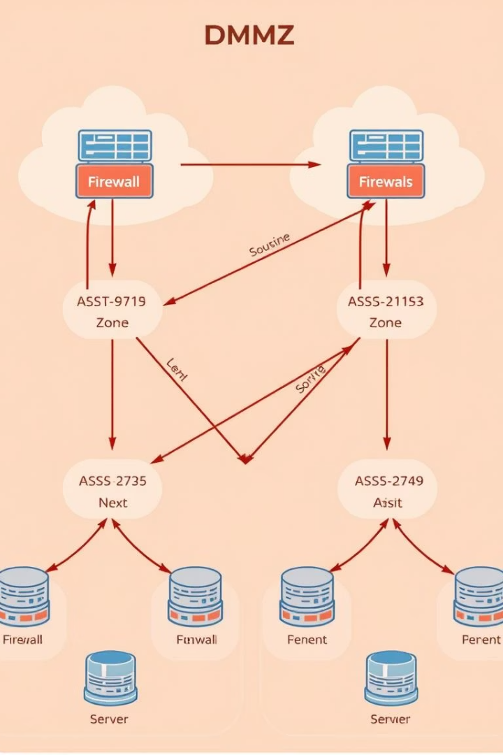




DMZ Architecture and Security Considerations
Perimeter Firewall
First layer filtering traffic between the internet and DMZ, blocking unauthorized access to internal resources.
Internal Firewall
Additional layer controlling traffic between DMZ and internal network, enforcing strict policies to protect core assets.
Segmentation
Proper segmentation limits lateral movement, confining potential intrusions to isolated DMZ zones.
Monitoring and Logging
Continuous surveillance and event logging are crucial for early threat detection within DMZ environments.
Notes:
11

Slide 15




Integrating Firewalls, VPNs, and DMZs: A Holistic Approach
Firewall Enforcement
Secure Remote Access
1
VPNs ensure encrypted connections for remote users and site links.
Acts as the gatekeeper enforcing policies across all network zones.
2
Continuous Monitoring
Service Isolation
Unified logging and alerts enable swift responses to suspicious activities.
4
DMZ protects public services by isolating them from the internal network.
3
Notes:
12

Slide 16

Case Studies: Real-World Examples of Effective Network Security
1
Financial Institution
2
Healthcare Provider
3
Global Enterprise
Implemented multi-layer firewalls with VPN for remote branches and DMZ for customer portal, reducing breaches by 40%.
Deployed segmented DMZs to protect sensitive patient data, combined with strict firewall policies and SSL VPN access.
Integrated next-gen firewalls with cloud VPN solutions and multi-zone DMZs enhancing threat visibility and rapid containment.
Notes:
13

Slide 17

Q&A and Next Steps: Fortifying Your Defenses
Assess Current Network
Conduct a comprehensive audit of existing firewall, VPN, and DMZ setups for vulnerabilities.
Implement Best Practices
Apply recommended firewall rules, choose the right VPN protocols, and properly segment DMZs.
Train Teams
Ensure all IT staff is trained on configuration standards and incident response procedures.
Continuous Improvement
Regularly monitor, update, and test your network security architecture to stay ahead of threats.
Notes:
14

Slide 18

THANK YOU
Delete Your History & Use VPN , DMZ, Firewall To Protect India & Protect Yourself

